Slide 1


Slide 2

#LifeKoKaroLift
SGC Coaching:
Articulate your Journey | Activate Students’ Vigour| Accelerate Mutual Growth
Session 7
Clustering

Slide 3
Agenda
Quick Recap – (15 mins)
Focused Teaching – (50 mins)
Last 2 weeks
Deep-Dive: Clustering/K-Mean
Review - Notebooks
Doubt resolution –(25 mins)

Slide 4
Recap: What the learner have learnt in the week
Quick Glance at Key Learnings
ML Techniques
Supervised Learning
Clustering
Kmean
Model Optimization
Elbow method
Unsupervised Learning

Slide 5
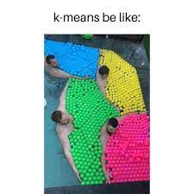
Meme: K-Mean

Slide 6
Focussed teaching: Deep-Dive of Clustering
Introduction
Applications
Choosing K value
Coding

Slide 7
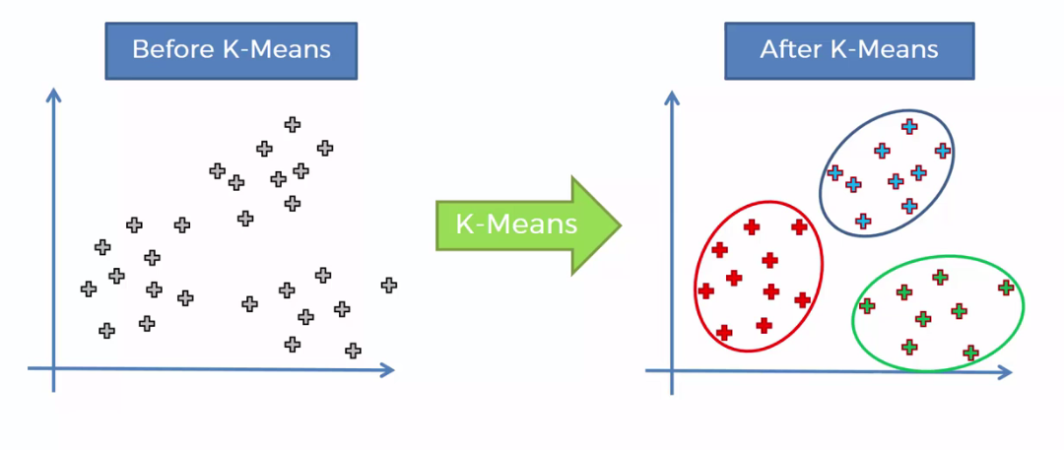
Introduction
**K-Means clustering** is the most popular unsupervised learning algorithm. It is used when we have un-labelled data which is data without defined categories or groups. The algorithm follows an easy or simple way to classify a given data set through a certain number of clusters, fixed apriority. K-Means algorithm works iteratively to assign each data point to one of K groups based on the features that are provided. Data points are clustered based on feature similarity.
Notes:
Explain Business context with above examples and your own industry experience
More details needed for business users, but other groups also need to understand applications.

Slide 8
Application
Image segmentation
Customer segmentation
Species clustering
Anomaly detection
Clustering languages
Notes:
Things to consider (Ideal vs. Real): Especially relevant for Tech background who have little experience in statistics.
Specification bias- Error in using right dependent and independent variables
Normality- Check for normal distribution to avoid bias
Multicollinearity- Variables must be independent of each other. Check correlation matrix
Autocorrelation- Autocorrelated dependent also results in autocorrelated error.
Heteroscedasticity- Check for homogeneity of data to reduce variance of output.
Observation count- Allow sufficient degrees of freedom and sample sufficiency.
Model quality options must be compared to each other to explain utility.
Some explanation on ML iterative mechanism will be helpful.

Slide 9
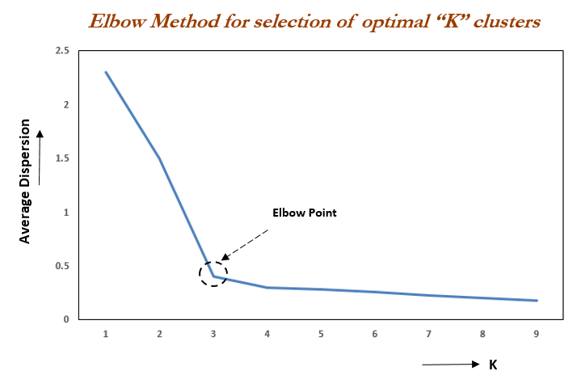
K Value
The K-Means algorithm depends upon finding the number of clusters and data labels for a pre-defined value of K. To find the number of clusters in the data, we need to run the K-Means clustering algorithm for different values of K and compare the results. So, the performance of K-Means algorithm depends upon the value of K. We should choose the optimal value of K that gives us best performance. There are different techniques available to find the optimal value of K. The most common technique is the elbow method which is described below.
Notes:
Show your own outputs in coding and explain each outcome carefully.

Slide 10
Focussed teaching: Let’s Code Together
Coding Time

